Slide 1
Final-presentation for CS 510: Advanced Information Retrieval
Group-20
Development: Document Comparison and Topic Modeling Tool
Bohao Wu (bohaowu), Shusen Han (shusenh2), Wenjie Guo (wenjie6)
Instructor: Prof. Chengxiang Zhai
Spring 2024/7th May
Notes:
Jugal intro upto - research goals

Slide 2
Motivation
Current Challenges in Text Analysis:
Limited Depth: Existing tools focus on superficial text comparisons, primarily identifying direct text repetitions or basic thematic overlaps.
Complex Needs: Researchers, content creators, and academic professionals require more nuanced analysis to understand the deeper relationships between texts.
Need for Advanced Analytical Tools:
Beyond Plagiarism: Moving past simple plagiarism detection to explore thematic depths and stylistic similarities.
Interdisciplinary Insights: Enabling deeper understanding across various fields such as literature, law, and academic research.
Our Solution:
Comprehensive Analysis: Combining thematic modeling with semantic analysis to provide a richer, more detailed understanding of text content.
User-Centric Design: Offering a tool that is not only powerful in its analytical capabilities but also accessible and easy to use for non-experts.

Slide 3
Development Highlights
Webpage
Main function: Compare the documents at the level of topics
Core function: PLSA or LDA (both are implemented)
Input: Two documents
Output:
Most relevant topic of each document and its word distribution
Mutually most common topic and its word distribution
Document similarity
LLM summary based on the results (powered by Gemini 1.5 pro)

Slide 4
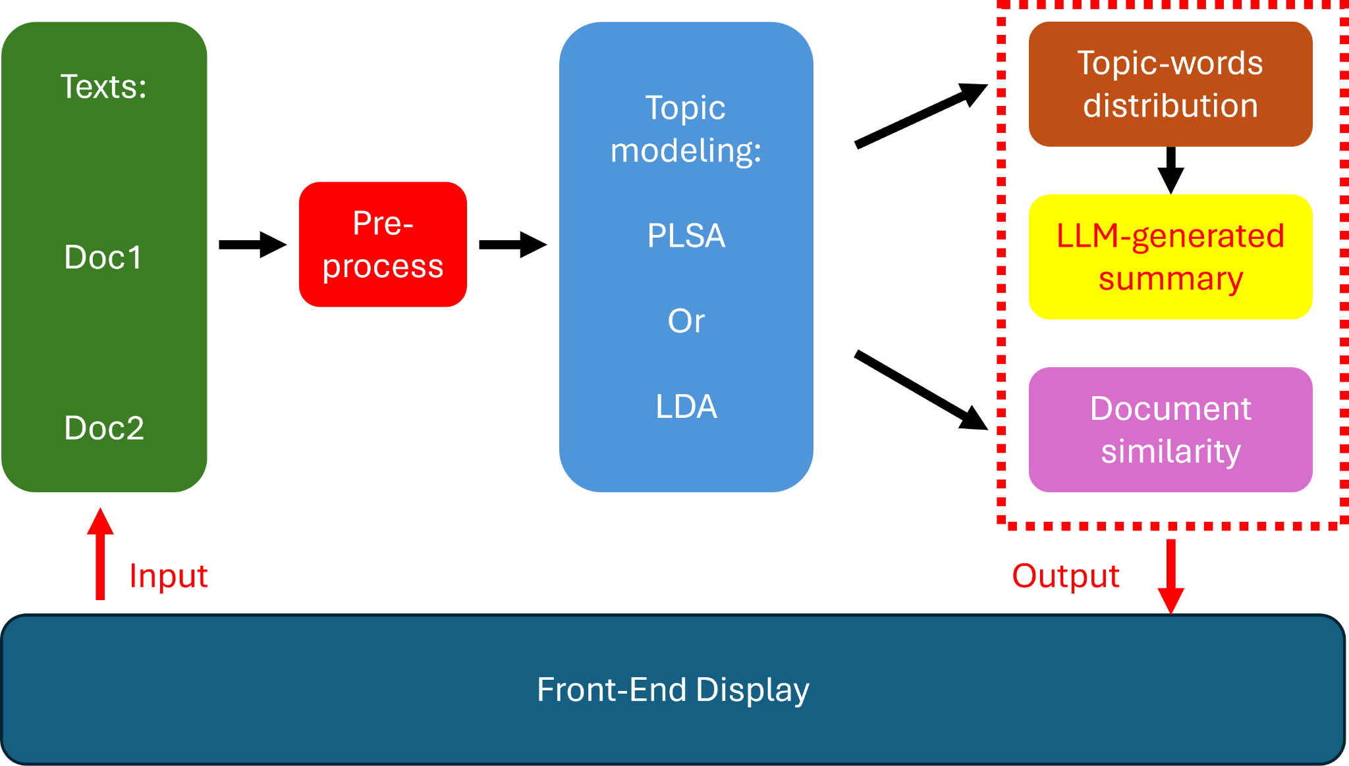
Tool Structure

Slide 5
Pre-process
Preprocessing Method 1:
Stopword Removal: Reads a list of stopwords from a file and removes these words from the input documents to focus on more meaningful words.
Word Tokenization and Filtering: Uses jieba for English/Chinese tokenization, filtering out short words, numbers, and stopwords.
Word Mapping and Counting: Maps each unique word to a unique ID and counts occurrences, creating two dictionaries.
Preprocessing Method 2:
Stopword Removal: Utilizes the NLTK library to remove English stopwords from the text.
Tokenization and Lemmatization: Tokenizes text into words and applies lemmatization to reduce words to their base or dictionary forms, ensuring that different forms of the same word are analyzed as a single item.

Slide 6
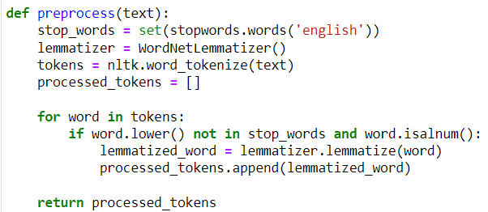
Implement
Text Postprocessing

Slide 7
Topic modeling
Overview:
Probabilistic Latent Semantic Analysis (PLSA): PLSA identifies latent topics in a collection of documents. It treats each document as a mixture of topics, where a topic is characterized by a distribution over words.
Latent Dirichlet Allocation (LDA): As an extension of PLSA that incorporates a Dirichlet prior on the topic distribution, LDA provides a more robust and generalizable method of topic modeling.
Key Functionalities:
Topic Discovery: Both PLSA and LDA analyze documents to discover the main themes that pervade a collection of documents.
Word Association: These methods statistically infer word associations to topics, helping to categorize and summarize the documents' contents.

Slide 8
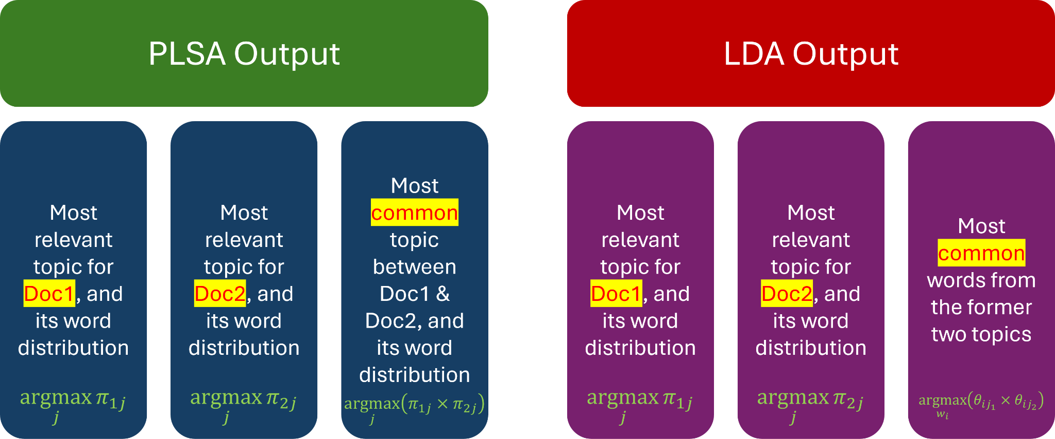
Tool Output from the models

Slide 9
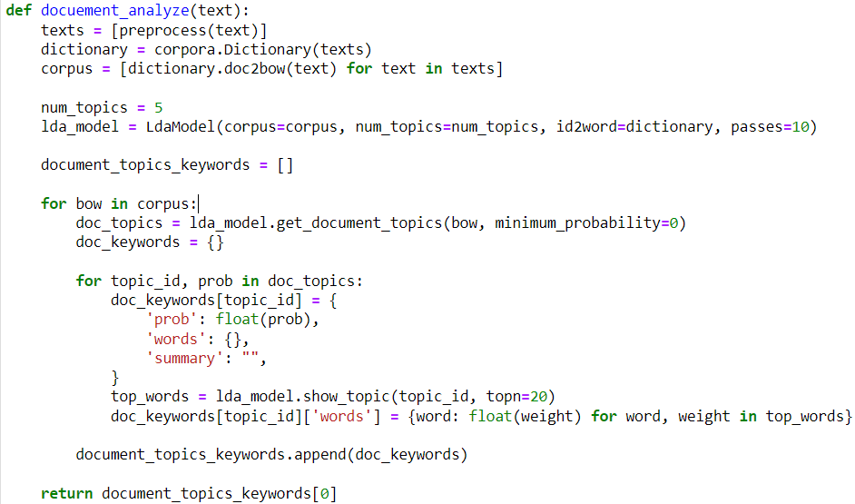
Topic Extraction Model
LDA

Slide 10
Similarity
Main idea:
Use embedding models to map the documents to high-dimensional vectors.
Compare the vector similarities of the two documents.
Apply different similarity metrics.

Slide 11
Similarity Measurement
Bert similarity
Use pretraining BERT embeddings to represent text
Encode variable-length text into fixed-length vectors

Slide 12
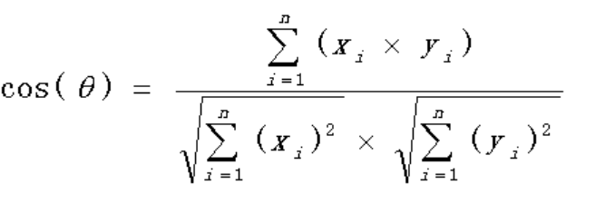
Similarity Measurement
Cosine Similarity
The cosine of the angle between the two vectors

Slide 13
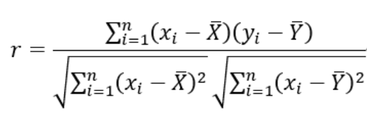
Similarity Measurement
Pearson correlation coefficient
measure of the strength and direction of the linear relationship between two continuous variables

Slide 14


Tools for Front-end
React
Django

Slide 15
Demo

Slide 16
Limitation and Future Work
Implement more advanced theme extraction models and choose the best one.
Improve the frontend
Add more functions like giving predictions of how likely the two documents are written by the same person.

Slide 17
Thanks for watching!

